Slide 1
TP N 2
BADIBANGA KABANEMI Jean Michel
TSHIAKAMA TSHIAMUKAMINA Rodriguez
Banza kasongo Daniel

Slide 2
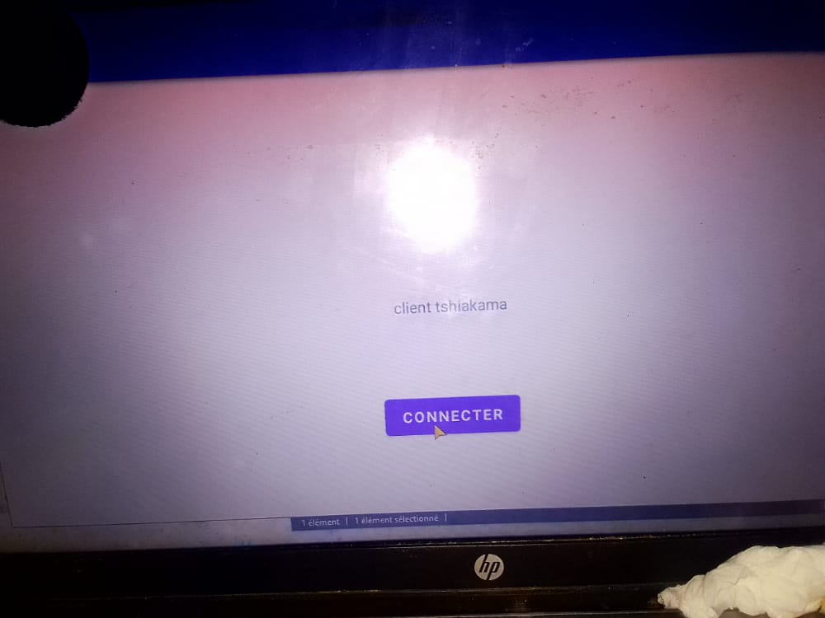
TP 2
Clic normal
Clic long

